Slide 1



Introduction to Hadoop Storage File System
Hadoop Storage File System (HDFS) is a distributed file system designed to store and manage large data sets. It provides high-throughput access to data and is fault-tolerant. Organizations use HDFS for big data applications, such as data analytics and machine learning.
Ba
by BHEEMARAM AKSHAYA

Slide 2
Benefits of using HDFS
Distributed Storage
Scalability
HDFS distributes data across multiple nodes, providing fault tolerance and high availability.
It can easily scale by adding more nodes and offers the ability to store and process large amounts of data.
Data Reliability
Cost-Efficiency
Replication of data ensures protection against data loss and allows for data recovery.
Using cost-effective commodity hardware makes HDFS a cost-efficient storage solution for big data.

Slide 3

Command to create the directory structure in HDFS
The command to create a directory structure in HDFS is hadoop fs -mkdir -p /path/to/hd. This command allows the creation of nested directories by using the -p flag, ensuring that parent directories are created as needed.

Slide 4

Explanation of the command: hadoop fs -mkdir -p /path/to/hd
The command "hadoop fs -mkdir -p /path/to/hd" is used to create a directory structure in HDFS. The "-mkdir -p" flag ensures that intermediate directories are created. This is essential for creating nested directories in HDFS with a single command.

Slide 5

Importance of the -p flag in the command
Preservation of parent directory: Ensures that all parent directories leading to the destination directory are created if they do not exist.
Prevents errors: Avoids potential errors by creating necessary parent directories along with the specified directory.
Efficient directory creation: Enables the efficient creation of complex directory structures with a single command.

Slide 6
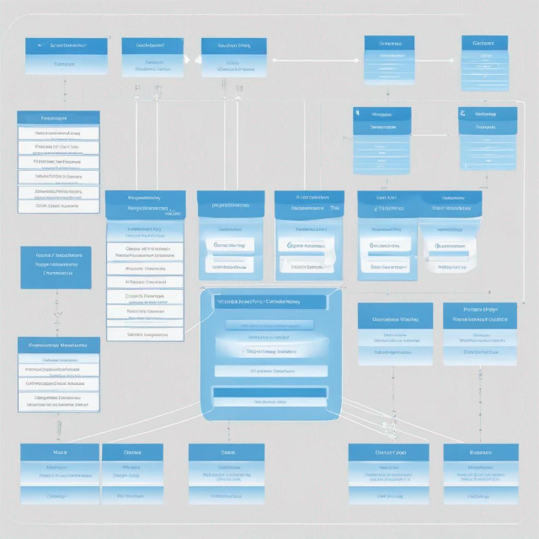
Example of creating a directory structure in HDFS
Creating a directory structure in Hadoop File System (HDFS) involves organizing data in a hierarchical manner.
By using the command hadoop fs -mkdir -p, users can create multiple directories within a single command.
This enables the efficient management of data in a distributed environment.

Slide 7
Best practices for creating directory structures in HDFS
Logical Organization
Optimal File Sizes
Metadata Management
Arrange directories based on data access patterns and usage frequency.
Store files of compatible sizes to enhance read and write performance.
Properly manage metadata to facilitate easier data retrieval and processing.

Slide 8



Common HDFS Errors and Troubleshooting
Error Messages
Debugging Tools
Troubleshooting Process
Correctly interpret error messages & logs to identify issues.
Utilize debugging tools like Hadoop log analysis for diagnostics.
Step-by-step troubleshooting process for HDFS issues.

Slide 9




Managing Directory Structures in HDFS
hadoop fs -ls /path
List the contents of a directory in HDFS.
hadoop fs -mv /path/src /path/dest
Move a file or directory within HDFS.
hadoop fs -rm -r /path
Delete a file or directory in HDFS.

Slide 10

Conclusion and Key Takeaways
After learning about Hadoop Storage File System, it's important to remember the benefits of using HDFS for distributed storage and processing. Understanding the command to create directory structures is crucial, along with best practices and common errors to avoid. This knowledge is essential for proficient HDFS management.

